Slide 1
Day 1
Japan
2024 Summer Camp

Slide 2

Ice Breaker Questions
Everyone stand up in a line
I will ask a question
Would you rather drink coke or pepsi?
If you would rather drink coke, move to the left
If you would rather drink pepsi, move to the right

Slide 3


Ice Breaker Questions
Do you like summer or winter?
Summer
Winter

Slide 4

Ice Breaker Questions
Can you whistle?
Yes
No

Slide 5






Ice Breaker Questions
Do you like cats or dogs?
cats
dogs

Slide 6

Ice Breaker Questions
Do you like mint chocolate?
Yes
No

Slide 7
Camp Rules
Be on time
Speak as much English as you can
Keep the classroom clean
Try your best

Slide 8
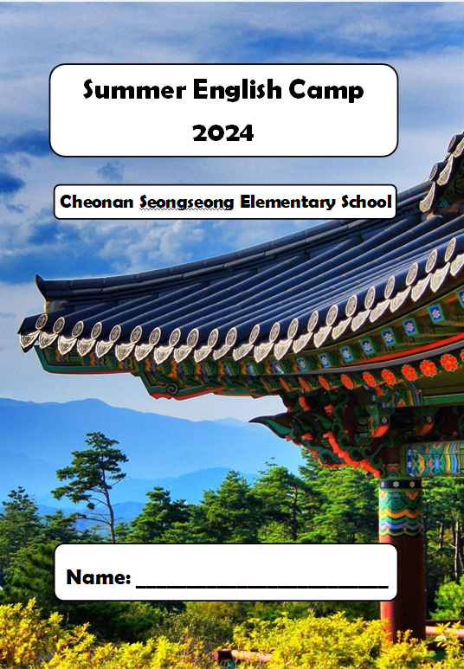
Camp Workbook

Slide 9
Japan
Day 1

Slide 10


VOCABULARY WORDS
PG 3
수도 발효시키다
capital city
ferment

Slide 11


VOCABULARY WORDS
전사 고대의
warrior
ancient

Slide 12
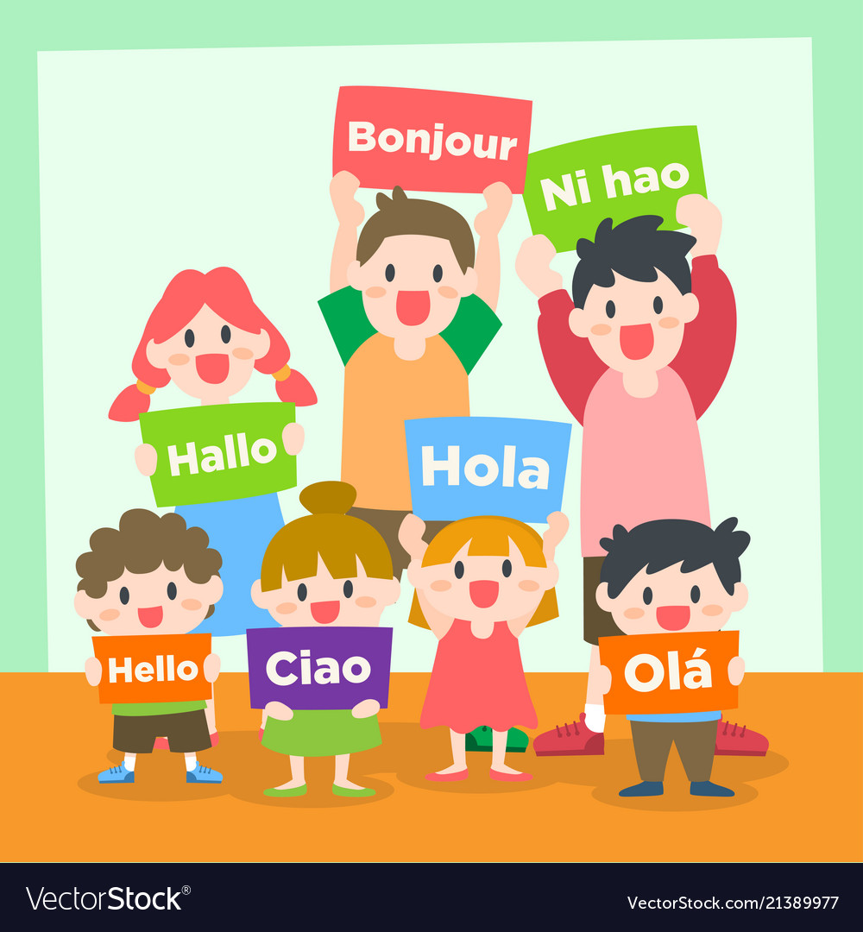
VOCABULARY WORDS
언어
language

Slide 13

Let’s Learn About Japan
Japan
Japanese flag name ___________
Draw the Japanese flag here
Nisshōki

Slide 14

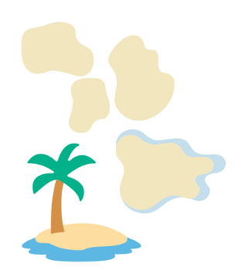
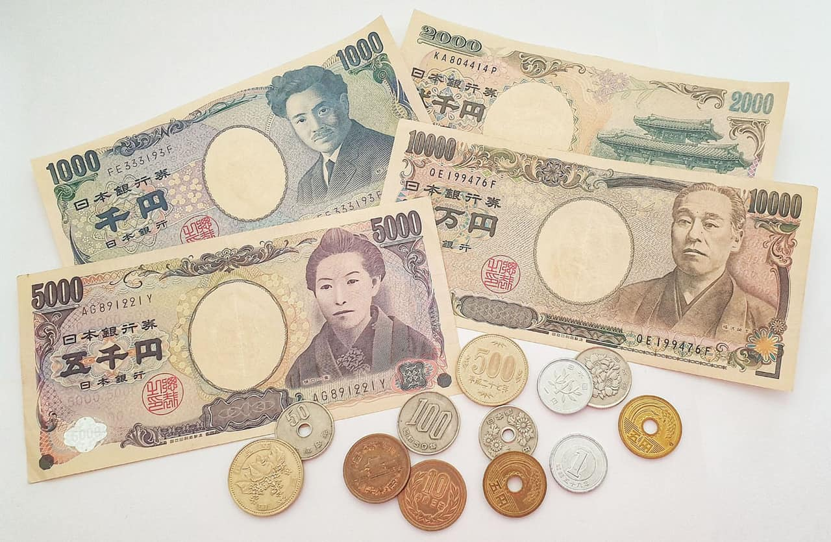
Let’s Learn About Japan
Capital city _______
Language _________
Tokyo
Japanese
Japanese Yen
nearly 7000
Japan has __________ islands.

Slide 15
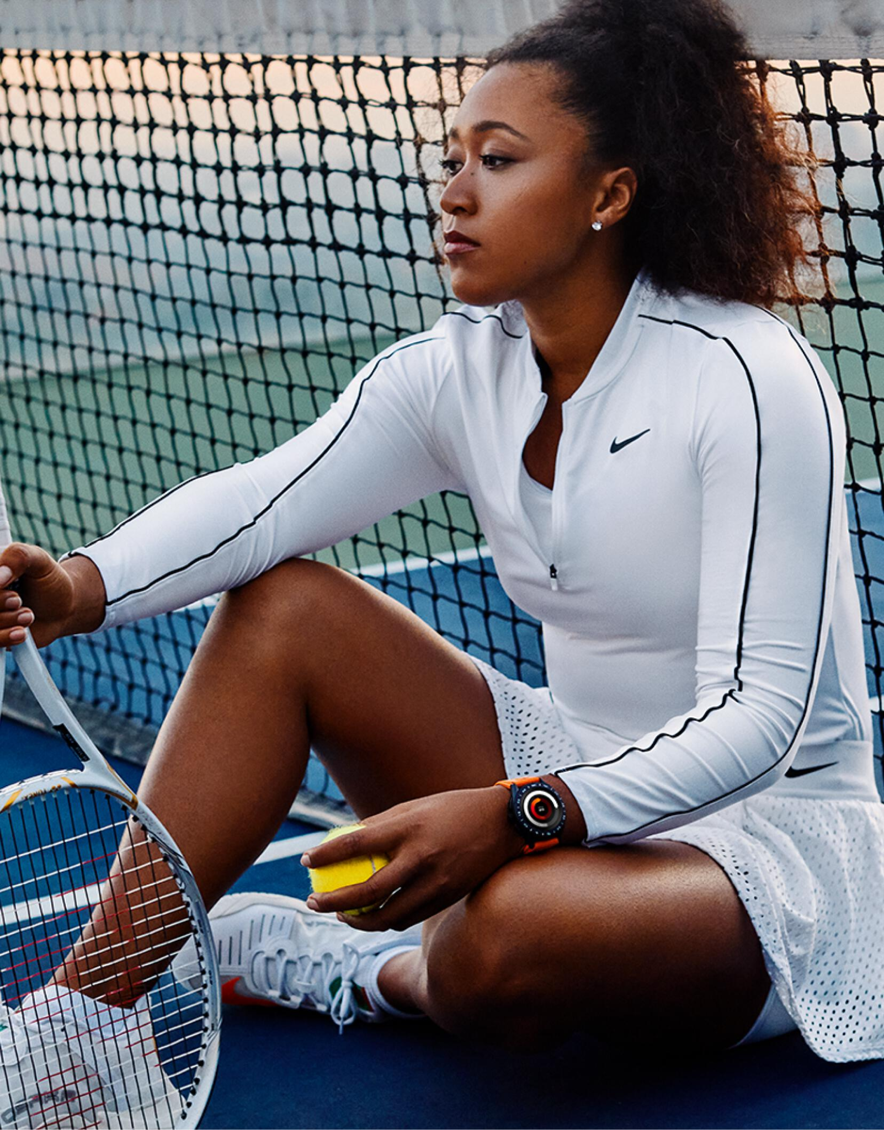
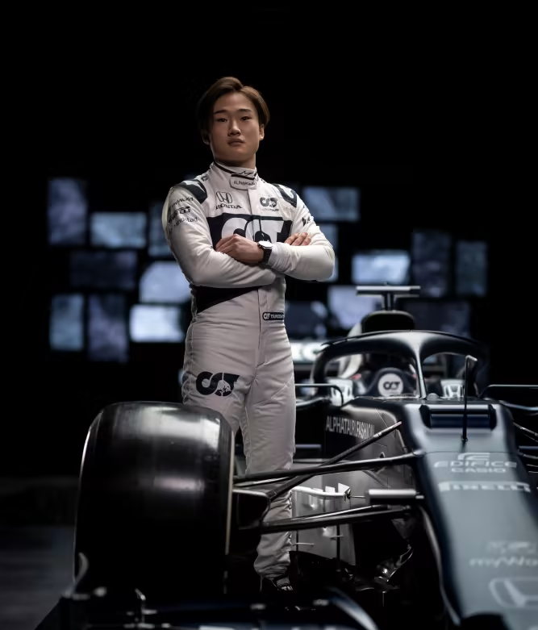
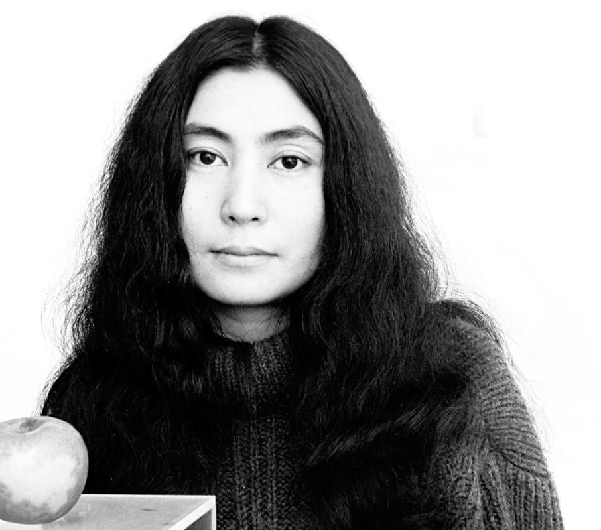
Famous People From Japan
I’m Naomi Osaka. I am a __________.
I’m Yoko Ono. I am an _______.
I’m Yuki Tsunoda. I am a __________ driver for Alpha Tauri.
Formula 1
tennis player
artist

Slide 16
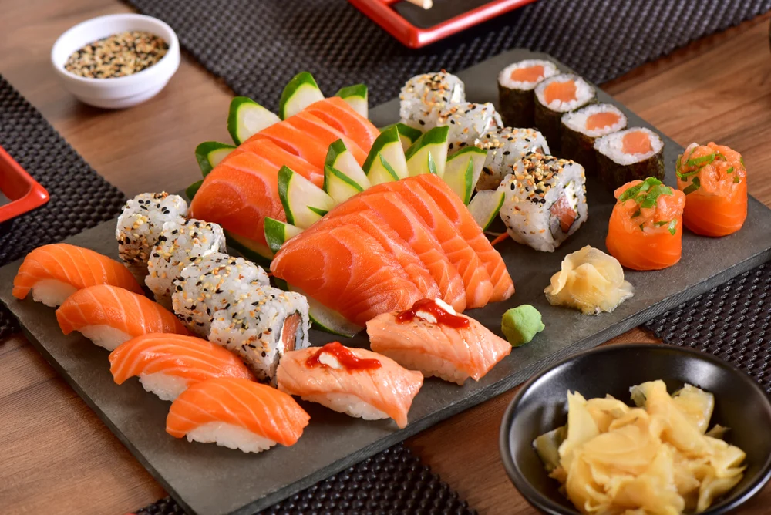
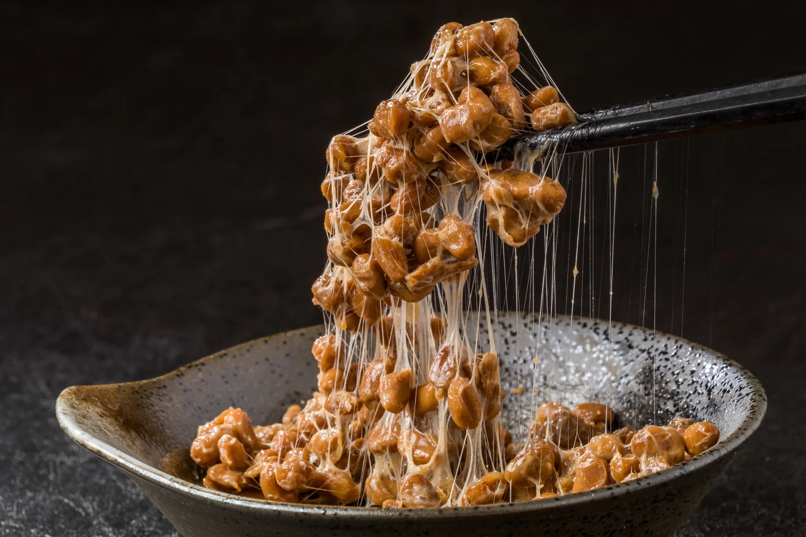
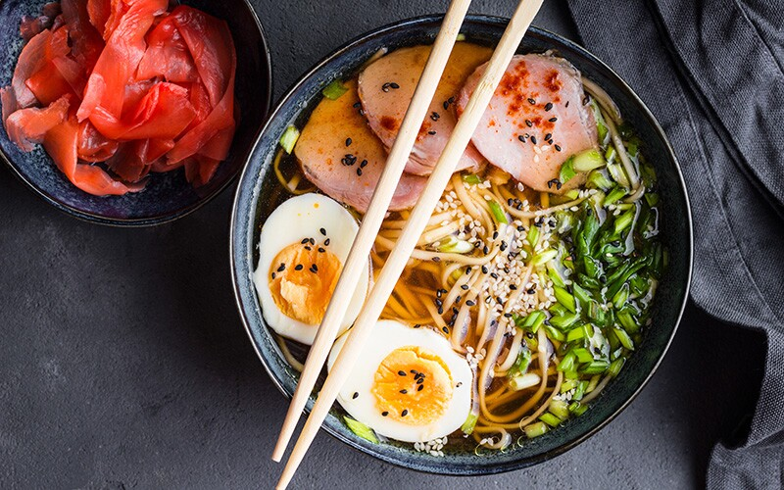
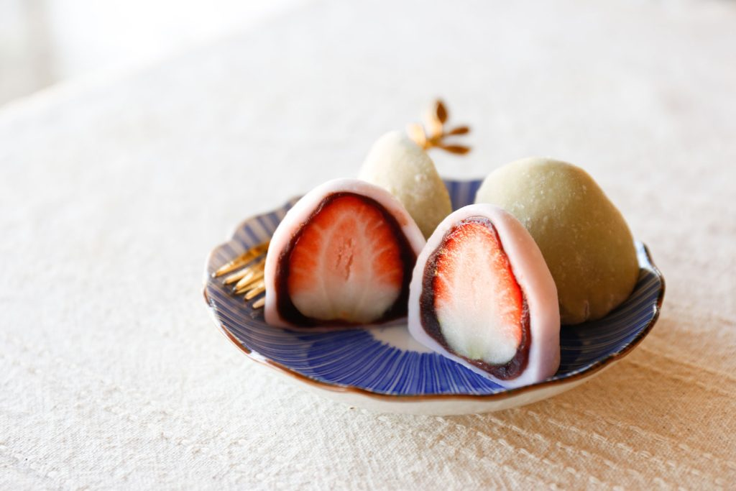
Japanese Culture and Food
Sushi
Nattō
Raw fish, rice and vegetables
Fermented soybeans
Ramen
Mochi
Noodle soup with different meats and vegetables
Rice cake

Slide 17
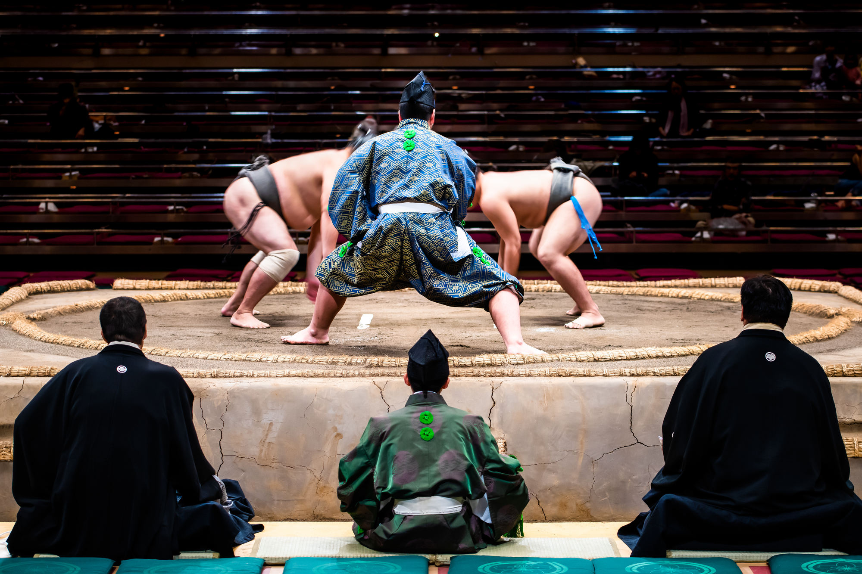
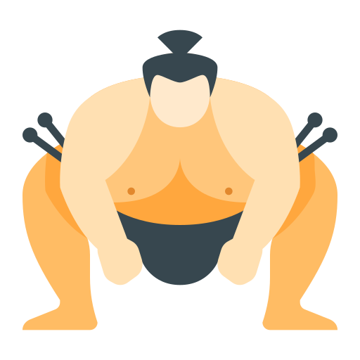
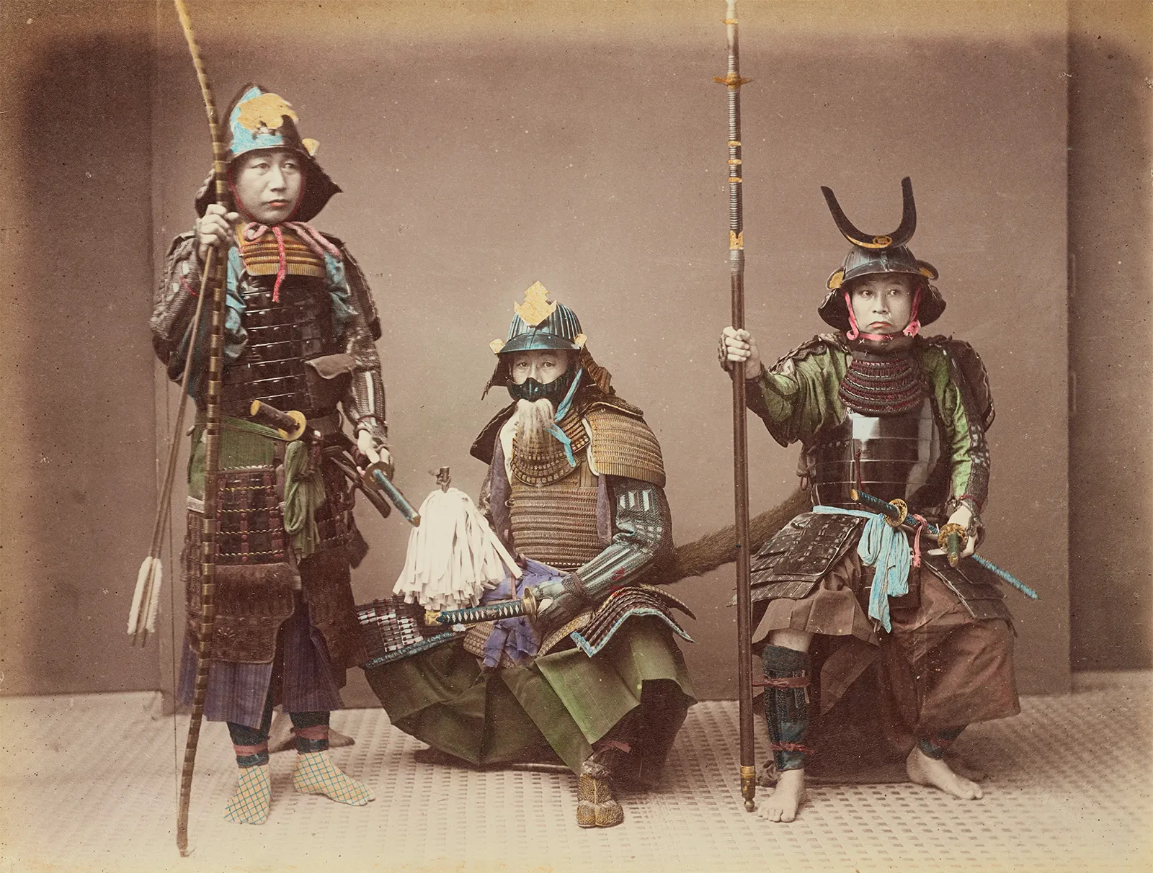

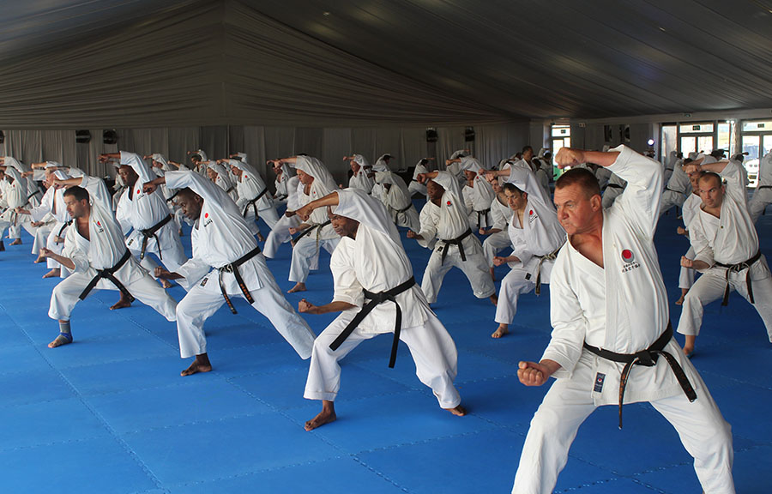
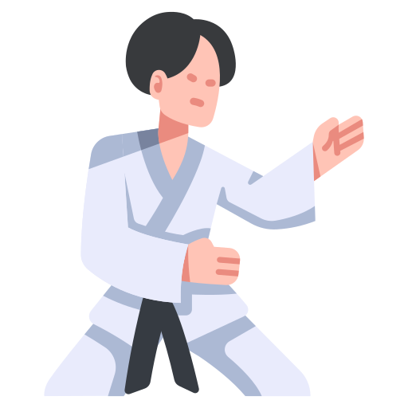
Japanese Culture and Food
Sumo Wrestling
Samurai
They are ancient _______.
warriors
Karate

Slide 18
Japanese Words
Arigatō
Ogenki desu ka?
thank you
English: ________
Korean: ________
English: __________
Korean: __________
how are you?
감사합니다
잘 지내세요?

Slide 19


FLIP CUP
Now we will play flip cup to practice what we learned about Japan.
Stand in a row behind your table
4
3
2
1

Slide 20

FLIP CUP
When I say GO, the first person picks up the cup, and reads the sentence
Blahh blahh blahh
1

Slide 21

FLIP CUP
When you have finished reading the sentence, put your cup on the edge of the table
Flip it upside down

Slide 22
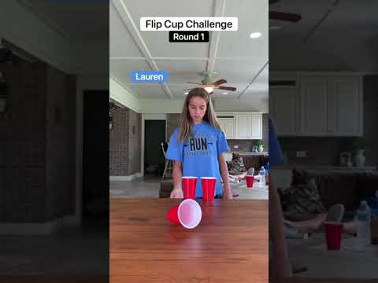
FLIP CUP

Slide 23
FLIP CUP
When you have flipped your cup, the next person reads the sentence.
First team to finish wins points
1
4
3
2
1

Slide 24
Ninja Star Target Practice
Team competition

Slide 25
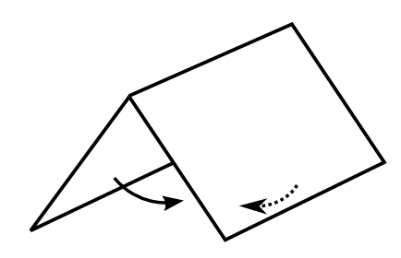


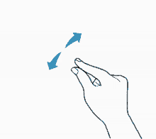
Some important origami words
Fold
Flip
Turn/Rotate
Pinch

Slide 26
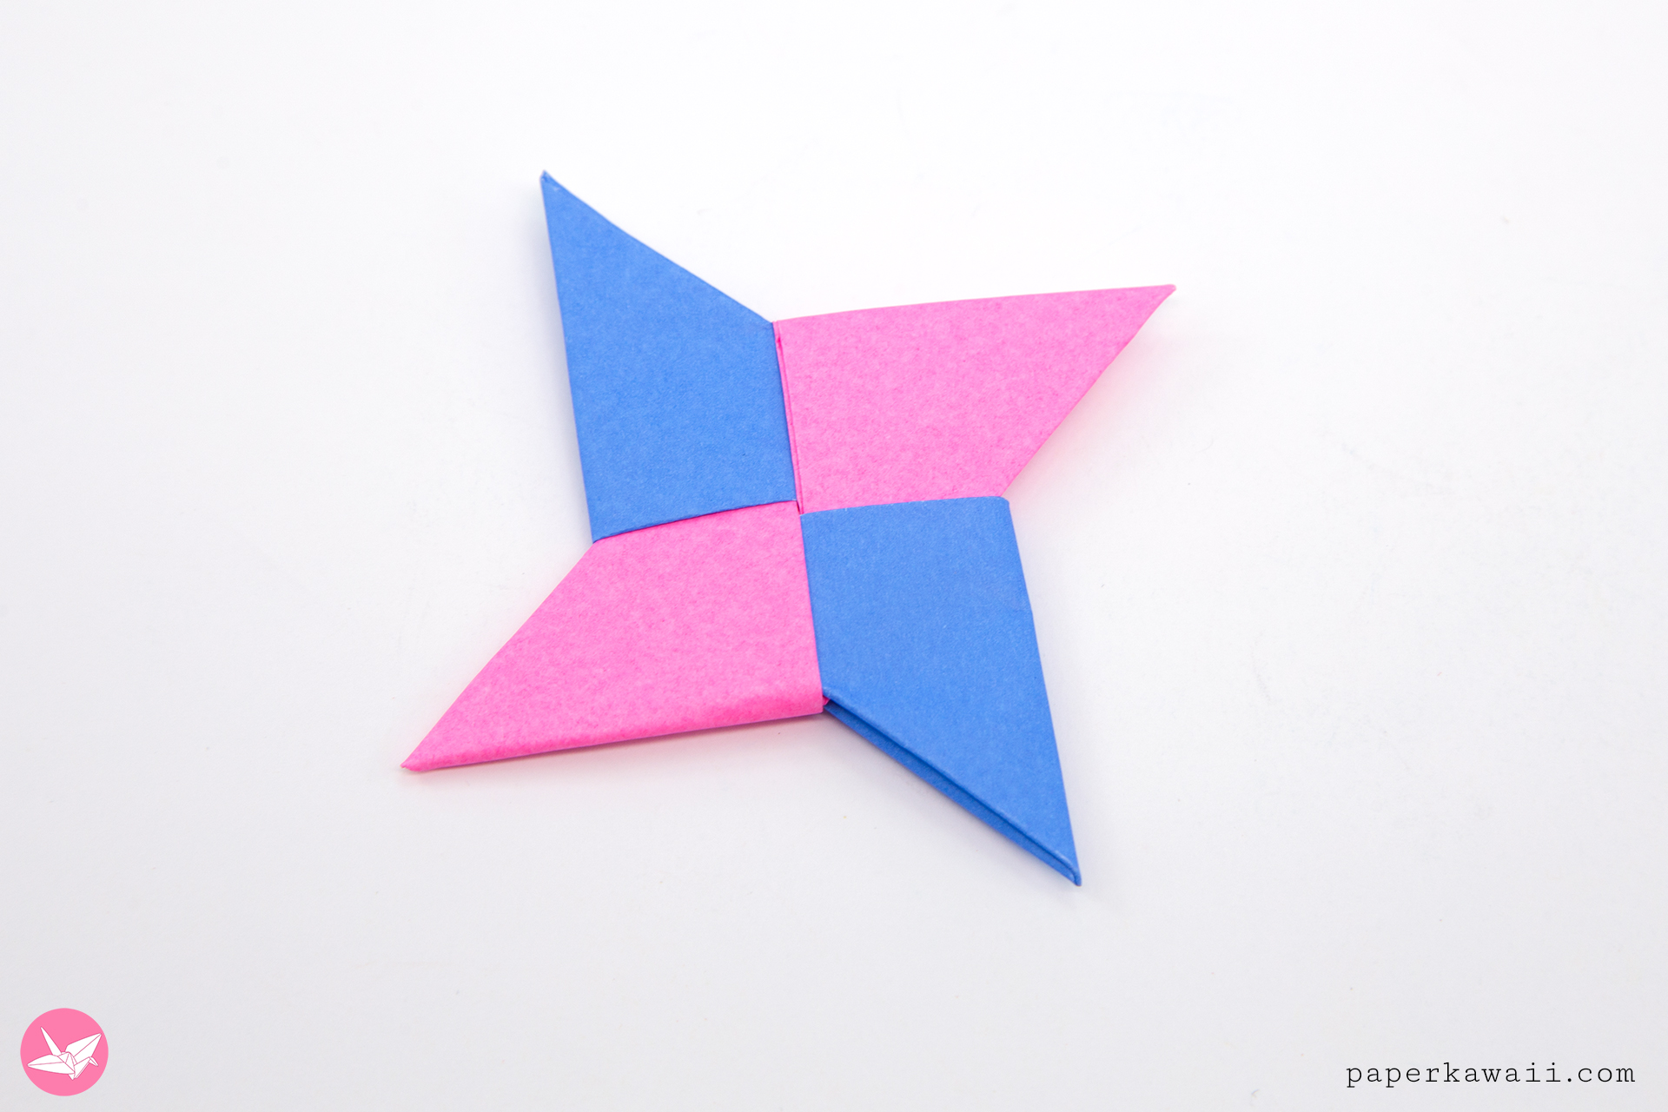
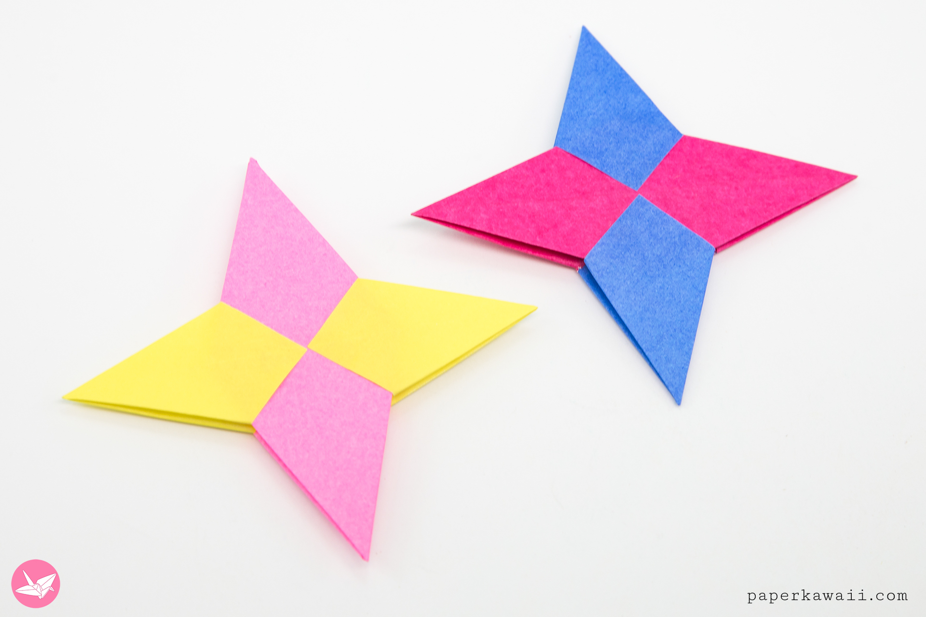
Ninja Stars

Slide 27
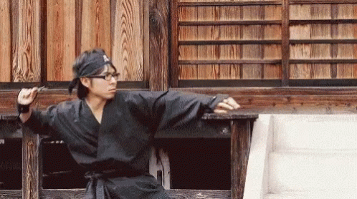
Target Practice
Practice throwing your ninja star for five minutes
You have four attempts to knock down the cup.
You will use your ninja star and your teammates ninja stars.

Slide 28
Journal Writing

Slide 29

Journal Writing
Pg 8
Write a few sentences in English about your day
Draw a picture about your day
What did you like?
What did you not like?
Remember, full sentences
Good journals get extra points!

Slide 30
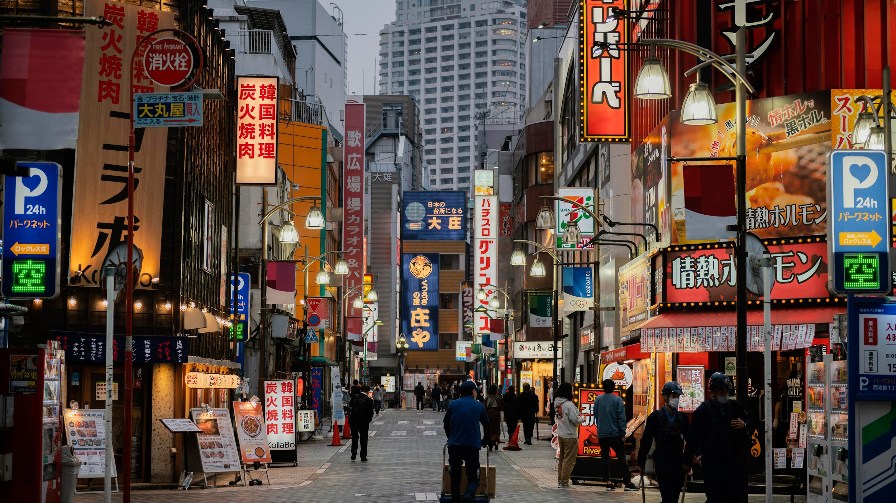
See you tomorrow! :)

